Slide 1

School of Information and Communication Technology
IT3910E – Project I
Social Media Information Reconnaissance Program and Synchronize AirTable
Supervisor: Tong Van Van, PhD
Authors:
Nguyen Thanh An 20225541
Pham Doan Phuc Lam 20225546

Slide 2
TABLE OF CONTENT
Introduction
Design
Demonstration
Version Control & Code Quality Analysis
Conclusion

Slide 3
INTRODUCTION
- The "Social Media Information Reconnaissance Program and Synchronize AirTable" project aims to automate the process of gathering, synchronizing, and analyzing social media data from Facebook.
- The system is designed to extract various types of user data, including user IDs, feeds, liked pages, and managed pages,...

Slide 4
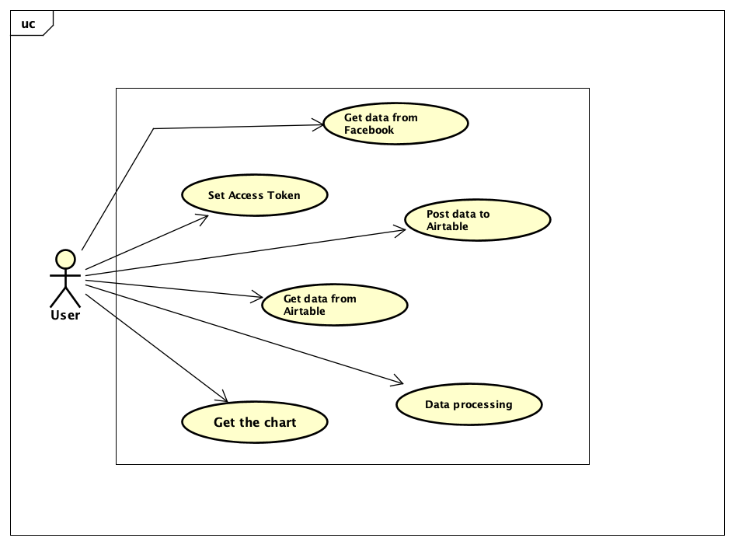
USE-CASE DIAGRAM

Slide 5
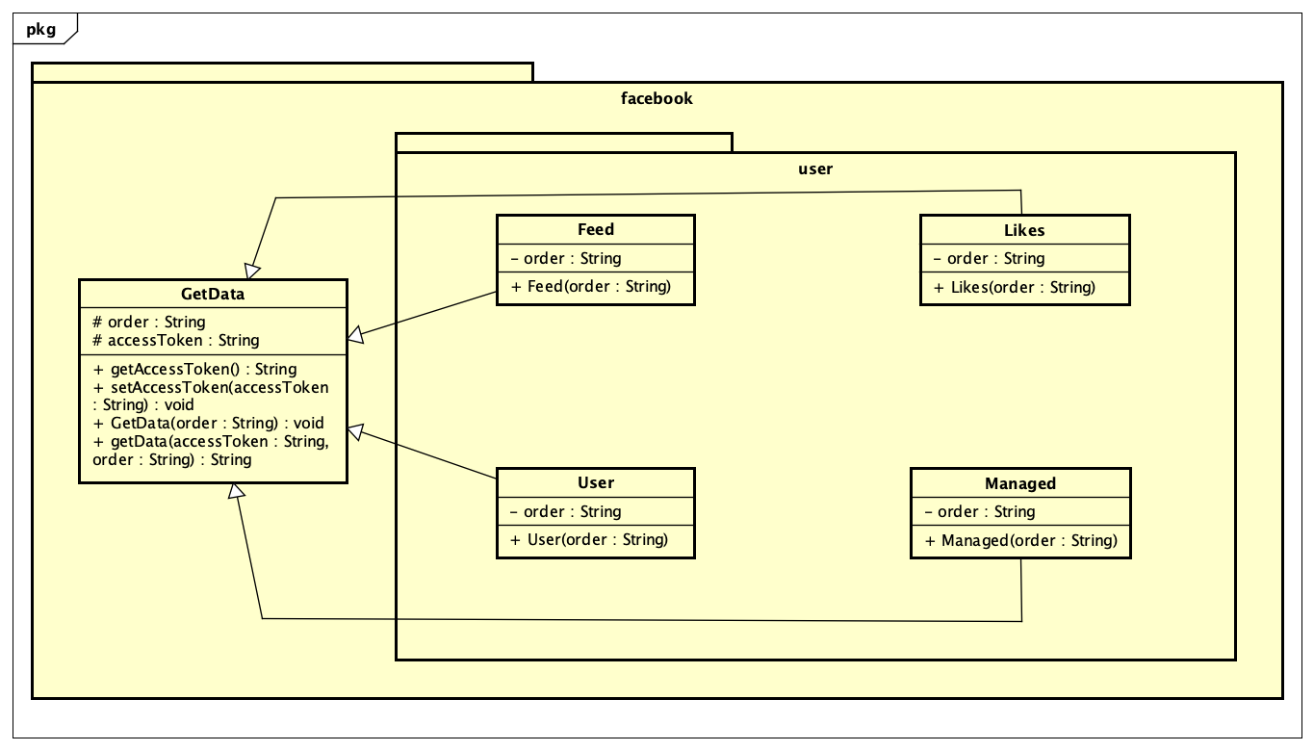
Package Class Diagram
Facebook Package’s Class Diagram

Slide 6
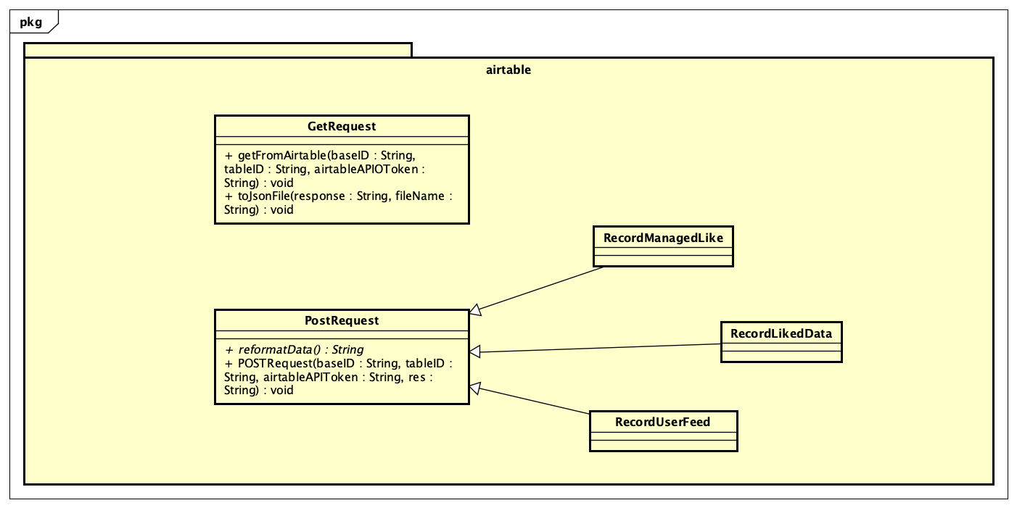
Package Class Diagram
Airtable Package’s Class Diagram

Slide 7
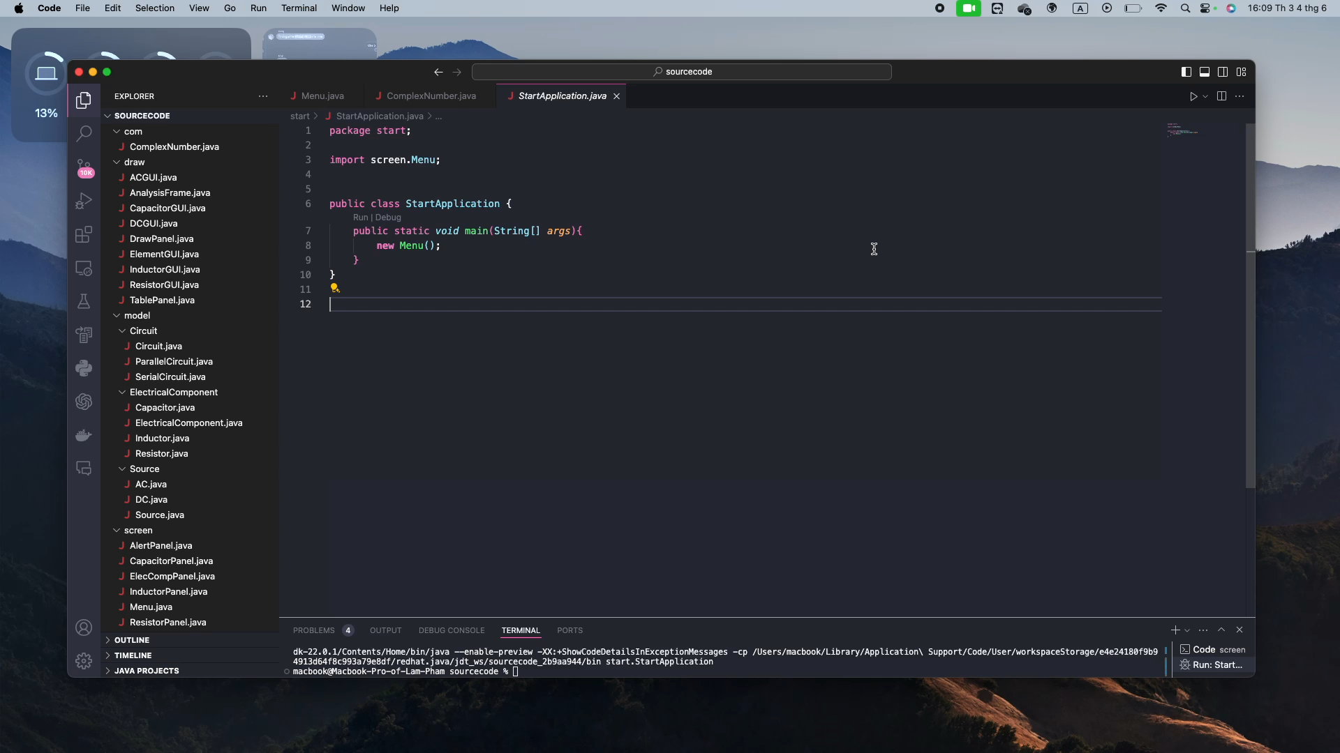
DEMONSTRATION

Slide 8
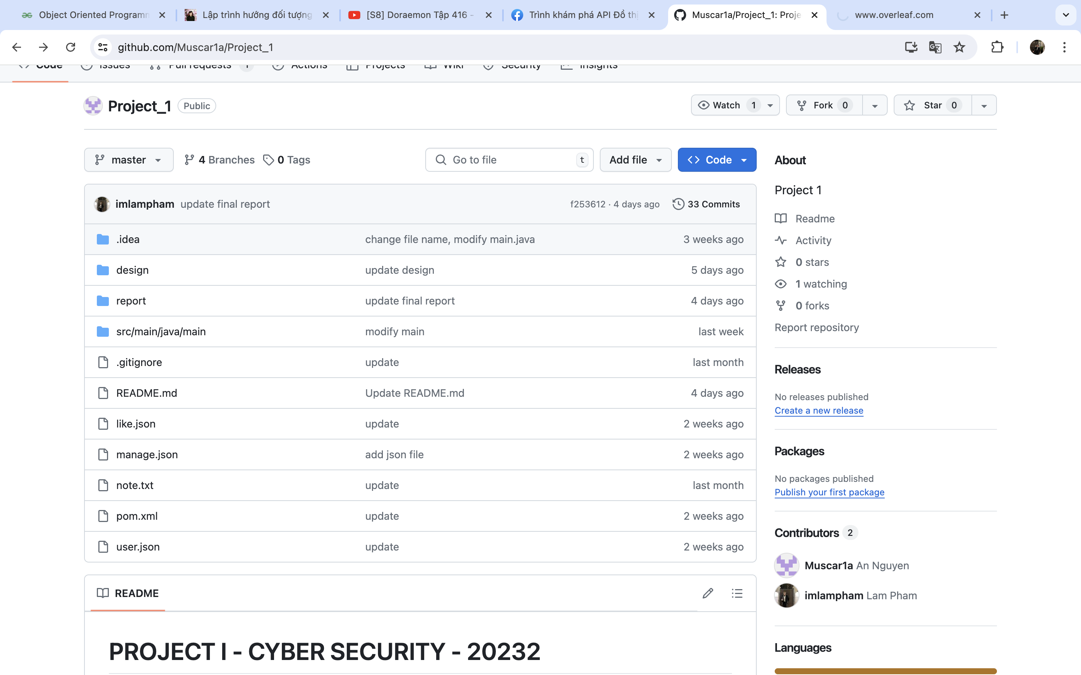
VERSION CONTROL & CODE QUALITY ANALYSIS

Slide 9
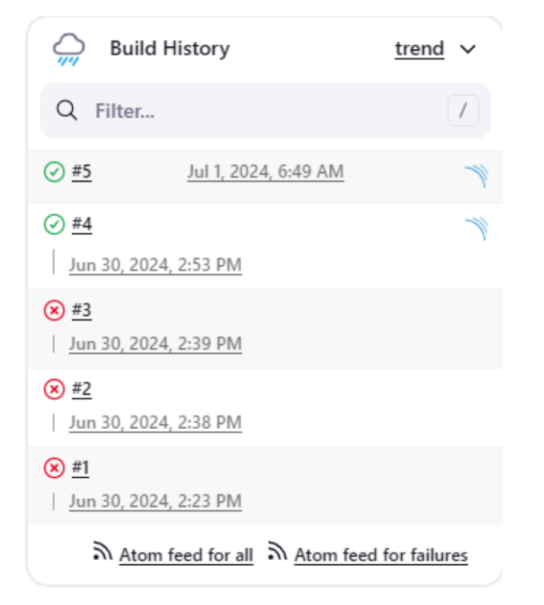
VERSION CONTROL & CODE QUALITY ANALYSIS

Slide 10
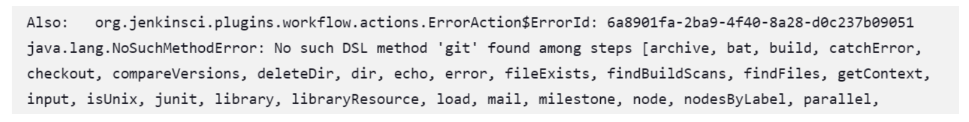
VERSION CONTROL & CODE QUALITY ANALYSIS

Slide 11
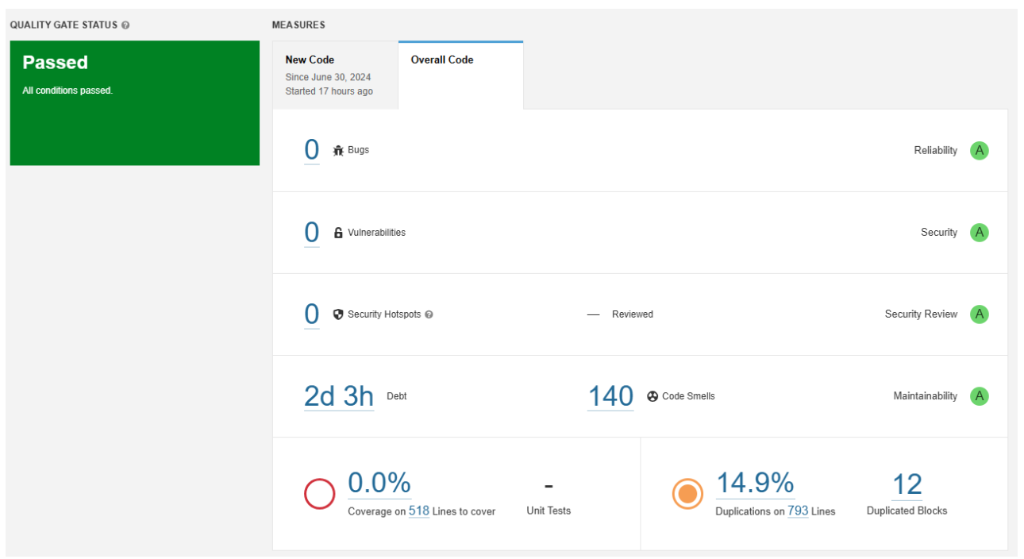
VERSION CONTROL & CODE QUALITY ANALYSIS

Slide 12
CONCLUSION
Comprehensive Data Collection: The project facilitates the retrieval of various types of data from Facebook, ensuring a broad and detailed dataset for analysis.
Efficient Data Synchronization: The synchronization process with AirTable ensures that data is organized and up-to-date, providing a reliable database for further analysis.
Robust Data Analysis: The statistical analysis and visualization tools included in the project allow users to derive meaningful insights from the data, presented in accessible Formats such as Excel reports and charts.
Enhanced Security and Privacy: The use of access tokens and adherence to privacy practices ensure that user data is handled securely throughout the process.

Slide 13
THANK YOU FOR YOUR ATTENTION!

